Slide 1
Collections framework --java.util “Without using collection concepts, you cannot develop any production level software application in Java” “Java collections framework is the most important concept for developing the project and crack interviews”

Slide 2
Collections Framework -A collection is a group of objects. -A collection in java is a container object that is used for storing multiple homogeneous and heterogeneous, duplicate, and unique elements without any size limitation. -A framework in java is a set of several classes and interfaces which provide a ready-made architecture. - A collections framework is a class library to handle groups of objects. -It allows to store, retrieve, and update a group of objects.

Slide 3
-Collections framework in Java supports two types of containers: =>collection :For storing a collection of elements (objects). => map :For storing key/value pairs. -Java collections framework provides an API to work with data structures such as lists, trees, sets, and maps. -It offers a set of reusable data structures, algorithms, and utilities for managing collections of objects in Java programming. -It saves developers time and effort by providing efficient implementations of common data structures.

Slide 4
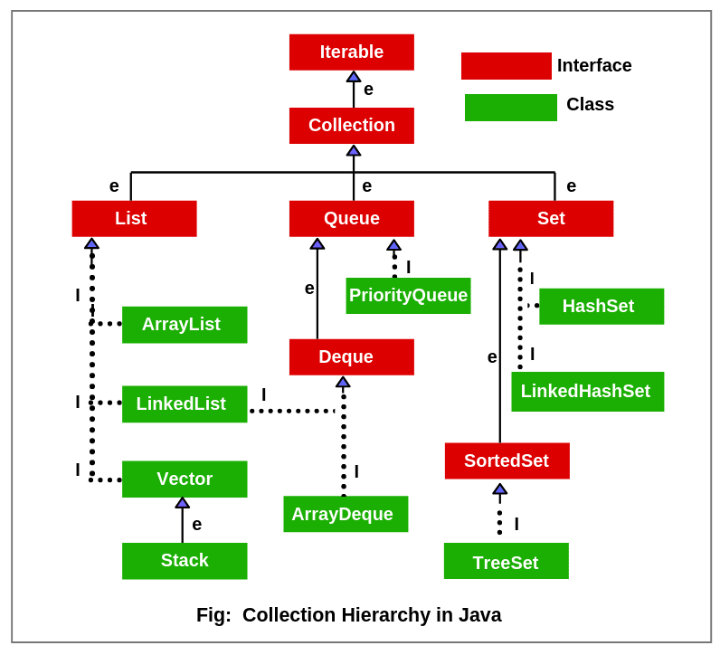

Slide 5
Key Interfaces in Collections Framework -Java programming language built the collections framework around four core interfaces: -Collection -List -Set -Map

Slide 6
-The basic interface of the collections framework is the Collection interface which is the root interface of all collections in the API . -It is placed at the top of the collection hierarchy in java. It provides the basic operations for adding and removing elements in the collection. -Collection interface extends the Iterable interface. The iterable interface has only one method called iterator(). The function of the iterator method is to return the iterator object. Using this iterator object, we can iterate over the elements of the collection. -List, Queue, and Set have three components which extends the Collection interface. A map is not inherited by Collection interface.

Slide 7
List of Interfaces defined in java.util package Collection List Queue Comparator ListIterator RandomAccess Deque Map Set Enumeration Map.Entry SortedMap EventListener NavigableMap SortedSet Formattable NavigableSet Iterator Observer

Slide 8
List of classes defined in java.util package AbstractCollection EventObject Random AbstractList FormattableFlags ResourceBundle AbstractMap Formatter Scanner AbstractQueue AbstractSequentialList HashMap AbstractSet HashSet Stack ArrayDeque Hashtable StringTokenizer ArrayList LinkedList Vector Collections EnumMap EnumSet Calender LinkedHashMap TreeMap

Slide 9
Collections Interface Methods add(): Add objects to collection. isEmpty(): Returns true if collection is empty clear(): Removes all elements from the collection remove(): Remove a selected object size(): Find the number of elements stream(): Return Sequential elements toArray(): Returns elements in array format hashCode():Returns Hashcode of the elements

Slide 10
Collections Interface Methods equals(obj X): Compare an element with the collection iterator(): Return an iterator over collection max(): Return max value in the collection contains(): Returns true is a particular value is present spliterator(): Creates splietarator over the elements in the collection retainAll(): Retains elements in the collection

Slide 11
List Interface 1. This interface represents a collection of elements whose elements are arranged sequentially ordered. 2. List maintains an order of elements means the order is retained in which we add elements, and the same sequence we will get while retrieving elements. 3. We can insert elements into the list at any location. The list allows storing duplicate elements in Java. 4. ArrayList, vector, and LinkedList are three concrete subclasses that implement the list interface.

Slide 12
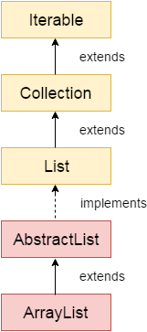
Java ArrayList class
Java ArrayList class uses a dynamic array for storing the elements. It inherits AbstractList class and implements List interface.
The important points about Java ArrayList class are:
Java ArrayList class can contain duplicate elements.
Java ArrayList class maintains insertion order.
Java ArrayList class is non synchronized.
Java ArrayList allows random access because array works at the index basis.
In Java ArrayList class, manipulation is slow because a lot of shifting needs to occur if any element is removed from the array list.

Slide 13
Java Non-generic Vs. Generic Collection
Java new generic collection allows you to have only one type of object in a collection. Now it is type safe so typecasting is not required at runtime.
Creating Array List
ArrayList<String> al=new ArrayList<String>();

Slide 14
Java ArrayList ArrayList can also be created using the interfaces it is implemented from List<String> list=new ArrayList<String>(); AbstractList<int> list1 = new ArrayList<int>();

Slide 15
Java ArrayList Example
public static void main(String args[]){
ArrayList<String> list=new ArrayList<String>();//Creating arraylist
list.add("Ravi");//Adding object in arraylist
list.add("Vijay");
list.add("Ravi");
list.add("Ajay");
//Invoking arraylist object
System.out.println(list);
}
Output :
[Ravi, Vijay, Ravi, Ajay]

Slide 16
Some important methods available in ArrayList class
boolean addAll(Collection C): This method is used to append all the elements from a specific collection to the end of the mentioned list, in such a order that the values are returned by the specified collection’s iterator.
boolean add(Object o): This method is used to append a specificd element to the end of a list.
boolean addAll(int index, Collection C): Used to insert all of the elements starting at the specified position from a specific collection into the mentioned list.
void add(int index, Object element): This method is used to insert a specific element at a specific position index in a list.

Slide 17
Some important methods available in ArrayList class
void clear(): This method is used to remove all the elements from any list.
remove​(int index): Removes the element at the specified position in this list.
remove​(Object o): Removes the first occurrence of the specified element from this list, if it is present.
removeAll​(Collection c): Removes from this list all of its elements that are contained in the specified collection.

Slide 18
Some important methods available in ArrayList class
set(int index, E element): Replaces the element at the specified position in this list with the specified element.
get​(int index): Returns the element at the specified position in this list
size​(): Returns the number of elements in this list.
isEmpty​(): Returns true if this list contains no elements.
listIterator​(): Returns a list iterator over the elements in this list (in proper sequence).
forEach​(Consumer action): Performs the given action for each element of the Iterable until all elements have been processed or the action throws an exception.
contains​(Object o): Returns true if this list contains the specified element.

Slide 19
Array List Methods Example - Add
public static void main(String args[]){
ArrayList<String> al=new ArrayList<String>();
al.add("Ajay");
System.out.println("Initial list of elements: \n"+al);
//Adding elements to the end of the list
al.add("Rahul");
System.out.println("add(E e) method: \n"+al);
//Adding an element at the specific position
al.add(1, "Gaurav");
System.out.println("add(int index, E element) method: \n"+al);
ArrayList<String> al2=new ArrayList<String>();
al2.add("Sonoo");
al2.add("Hanumat") ;
//Adding second list elements to the first list
al.addAll(al2);
System.out.println("addAll(Collection<? extends E> c) method: \n"+al);
ArrayList<String> al3=new ArrayList<String>(al2);
//Adding second list elements to the first list at specific position
al.addAll(1, al3);
System.out.println("addAll(int index, Collection<? extends E> c) method: \n"+al);
}

Slide 20
Output :
Initial list of elements:
[Ajay]
After invoking add(E e) method:
[Ajay, Rahul]
After invoking add(int index, E element) method:
[Ajay, Gaurav, Rahul]
After invoking addAll(Collection<? extends E> c) method:
[Ajay, Gaurav, Rahul, Sonoo, Hanumat]
After invoking addAll(int index, Collection<? extends E> c) method: [Ajay, Sonoo, Hanumat, Gaurav, Rahul, Sonoo, Hanumat]

Slide 21
Java ArrayList example to remove elements
public static void main(String [] args)
{
ArrayList<String> al=new ArrayList<String>();
al.add("Ravi");
al.add("Vijay");
al.add("Ajay");
al.add("Jason");
System.out.println("An initial list of elements: "+al);
//Removing specific element from arraylist
al.remove("Vijay");
System.out.println("After invoking remove(object) method: "+al);
//Removing element on the basis of specific position
al.remove(0);
System.out.println("After invoking remove(index) method: "+al);
//Creating another arraylist
ArrayList<String> al2=new ArrayList<String>();
al2.add("Ravi");
al2.add("Hanumat");
//Adding new elements to arraylist
al.addAll(al2);
System.out.println("Updated list : "+al);
//Removing all the new elements from arraylist
al.removeAll(al2);
System.out.println("After invoking removeAll() method: "+al);
//Removing elements on the basis of specified condition
al.removeIf(str -> str.contains("Ajay"));
//Here, we are using Lambda expression
System.out.println("After invoking removeIf() method: "+al);
//Removing all the elements available in the list
al.clear();
System.out.println("After invoking clear() method: "+al);
}

Slide 22
Output :
An initial list of elements: [Ravi, Vijay, Ajay, Jason]
After invoking remove(object) method: [Ravi, Ajay, Jason]
After invoking remove(index) method: [Ajay, Jason]
Updated list : [Ajay, Jason, Ravi, Hanumat]
After invoking removeAll() method: [Ajay, Jason]
After invoking removeIf() method: [Jason]
After invoking clear() method: []

Slide 23
Java ArrayList example of isEmpty(),retainAll(),get(),set()
public static void main(String args[]){
ArrayList<String> al=new ArrayList<String>();
System.out.println("Is ArrayList Empty: "+al.isEmpty());
al.add("Ravi");
al.add("Vijay");
System.out.println("Is ArrayList Empty: "+al.isEmpty());
System.out.println("Before update: "+al.get(1));
al.set(1,"Gaurav");
System.out.println("After update: "+al.get(1));
System.out.println("After updating the list: "+al);
ArrayList<String> al2=new ArrayList<String>();
al2.add("Ravi");
al2.add("Hanumat");
al.retainAll(al2);
System.out.println("After retainAll() : "+al);
}
Output :
Is ArrayList Empty: true
Is ArrayList Empty: false
Before update: Vijay
After update: Gaurav
After updating the list: [Ravi, Gaurav]
After retainAll() : [Ravi]

Slide 24
Difference between Arrays and ArrayList
Sl.No | Array | ArrayList
1 | Fixed size arrays | Size need not be specified. Even if specify a capacity, we can add elements later
2 | Accessed using index in [] | ArrayList has methods to access it’s elements
3 | Array can contain primitive and non-primitive data types | ArrayList supports only objects
4 | Primitive datatypes are stored in contiguous locations. In case of objects, allocation is similar to ArrayList | Members are always references to objects at different memory locations. References are stored at contiguous locations

Slide 25
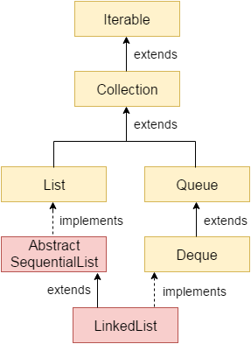
Java LinkedList class
Java LinkedList are:
Java LinkedList class can contain duplicate elements.
Java LinkedList class maintains insertion order.
Java LinkedList class is non synchronized.
In Java LinkedList class, manipulation is fast because no shifting needs to occur.
Java LinkedList class can be used as a list, stack or queue.

Slide 26
Java LinkedList Example
public static void main(String args[]){
LinkedList<String> al=new LinkedList<String>();
al.add("Ravi");
al.add("Vijay");
al.add("Ravi");
al.add("Ajay");
Iterator<String> itr=al.iterator();
while(itr.hasNext()){
System.out.println(itr.next());
}
}
Output :
Ravi
Vijay
Ravi
Ajay

Slide 27
LinkedList example – addfirst(), addlast(),removeFirst(),removelast() etc…
public static void main(String [] args) { LinkedList<String> ll=new LinkedList<String>();
ll.add("Ravi");
ll.add("Ravi");
ll.add("Vijay");
ll.add("Ajay");
System.out.println("Initial list of elements: "+ll);
//Removing first element from the list ll.removeFirst();
System.out.println("removeFirst() method: "+ll);
//Removing lastt element from the list ll.removeLast();
System.out.println("removeLast() method: "+ll);
ll.addFirst("Vijay");
ll.addLast("Ravi"); System.out.println("Updated list : "+ll);
//Removing first occurrence of element from the list
ll.removeFirstOccurrence("Vijay"); System.out.println("removeFirstOccurrence() method: "+ll);
//Removing last occurrence of element from the list
ll.removeLastOccurrence("Ravi"); System.out.println("removeLastOccurrence() method: "+ll);
//Removing of element on condition from list
ll.removeIf(str->str.contains("Vijay")); System.out.println("After invoking removeIf() method: "+ll);
//Removing all the elements available in the list
ll.clear();
System.out.println("clear() method: "+ll);
}

Slide 28
Output :
Initial list of elements: [Ravi, Ravi, Vijay, Ajay]
removeFirst() method: [Ravi, Vijay, Ajay]
removeLast() method: [Ravi, Vijay]
Updated list : [Vijay, Ravi, Vijay, Ravi]
removeFirstOccurrence() method: [Ravi, Vijay, Ravi]
removeLastOccurrence() method: [Ravi, Vijay]
After invoking removeIf() method: [Ravi]
clear() method: []

Slide 29
Vector Class
Java Vector class comes under the java.util package. The vector class implements a growable array of objects. Like an array, it contains the component that can be accessed using an integer index.
Vector is very useful if we don't know the size of an array in advance or we need one that can change the size over the lifetime of a program.
Vector implements a dynamic array that means it can grow or shrink as required. It is similar to the ArrayList, but with some differences
Vector is synchronized.
The vector contains some legacy methods that are not the part of a collections framework
Vector expands it’s capacity by 100% if not explicitly implied. ArrayList grows 50% of it’s size when it has more than it’s original size
Unless there is a specific need, it is better to use ArrayList than a Vector

Slide 30
Vector Class
Members of a Vector
protected int capacityIncrement //The amount by which the capacity of the vector is automatically incremented when its size becomes greater than its capacity.
protected int elementCount //The number of valid components in this Vector object.
protected Object[] elementData //The array buffer into which the components of the vector are stored.
Methods that are specific to a Vector class
int capacity() Returns the current capacity of this vector.
ensureCapacity(int minCapacity)
Increases the capacity of this vector, if necessary, to ensure that it can hold at least the number of components specified by the minimum capacity argument.

Slide 31
int capacity(): This method returns the current capacity of this vector as an integer value. Here capacity means the length of its internal data array, kept in the field elementData of this vector.
import java.util.*;
class Vector_demo {
public static void main(String[] arg)
{
Vector vec = new Vector(4);
// use add() method to add elements in the vector
vec.add(1);
vec.add(2);
vec.add(3);
vec.add(4);
System.out.println("Capacity of vector: " + vec.capacity());
}
}
Output: Capacity of vector: 4

Slide 32
void ensureCapacity(int minCapacity): This method increases the capacity of this vector, if necessary, to ensure that it can hold at least the number of components specified by the minimum capacity argument .
import java.util.*;
class Vector_demo {
public static void main(String[] arg)
{
// create default vector of capacity 10
Vector v = new Vector();
// ensuring capacity
v.ensureCapacity(22);
// cheking capacity
System.out.println("Minimum capacity: " + v.capacity());
}
}
Output : Minimum capacity: 22

Slide 33
Stack Class in Java
Java Collection framework provides a Stack class which models and implements Stack data structure.
The class is based on the basic principle of last-in-first-out. In addition to the basic push and pop operations, the class provides three more functions of empty, search and peek.
The class can also be said to extend Vector and treats the class as a stack with the five mentioned functions. The class can also be referred to as the subclass of Vector.
The class provides one default constructor which creates an empty stack

Slide 34
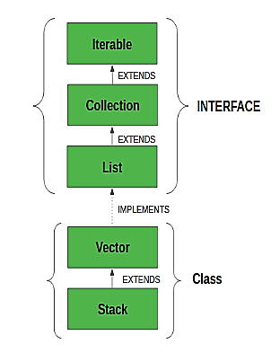
This diagram shows the hierarchy of Stack class:

Slide 35
Methods in Stack class
Object push(Object element) : Pushes an element on the top of the stack.
Object pop() : Removes and returns the top element of the stack. An ‘EmptyStackException’ exception is thrown if we call pop() when the invoking stack is empty.
Object peek() : Returns the element on the top of the stack, but does not remove it.
boolean empty() : It returns true if nothing is on the top of the stack. Else, returns false.
int search(Object element) : It determines whether an object exists in the stack. If the element is found, it returns the position of the element from the top of the stack. Else, it returns -1.

Slide 36
Queue Interface 1. A queue is an ordered of the homogeneous group of elements in which new elements are added at one end(rear) and elements are removed from the other end(front). 2. This interface represents a special type of list whose elements are removed only from the head. 3. LinkedList, Priority queue, ArrayQueue, Priority Blocking Queue, and Linked Blocking Queue are the concrete subclasses that implement the queue interface.

Slide 37
Methods in Queue:
add()- This method is used to add elements at the tail of queue. More specifically, at the last of linked-list if it is used, or according to the priority in case of priority queue implementation.
peek()- This method is used to view the head of queue without removing it. It returns Null if the queue is empty.
element()- This method is similar to peek(). It throws NoSuchElementException when the queue is empty.
remove()- This method removes and returns the head of the queue. It throws NoSuchElementException when the queue is empty.
poll()- This method removes and returns the head of the queue. It returns null if the queue is empty.
size()- This method return the no. of elements in the queue.

Slide 38
import java.util.LinkedList;
import java.util.Queue;
public class QueueExample
{
public static void main(String[] args)
{
Queue<Integer> q = new LinkedList<>();
// Adds elements {0, 1, 2, 3, 4} to queue
for (int i=0; i<5; i++)
q.add(i);
// Display contents of the queue.
System.out.println("Elements of queue-"+q);
// To remove the head of queue.
int removedele = q.remove();
System.out.println("removed element-" + removedele);
System.out.println(q);

Slide 39
// To view the head of queue
int head = q.peek();
System.out.println("head of queue-" + head);
int size = q.size();
System.out.println("Size of queue-" + size);
}
}
Output:
Elements of queue-[0, 1, 2, 3, 4]
removed element-0
[1, 2, 3, 4]
head of queue-1
Size of queue-4

Slide 40
Set Interface 1. This interface represents a collection of elements that contains unique elements. i.e, It is used to store the collection of unique elements. 2. Set interface does not maintain any order while storing elements and while retrieving, we may not get the same order as we put elements. All the elements in a set can be in any order. 3. Set does not allow any duplicate elements. 4. HashSet, LinkedHashSet, TreeSet classes implements the set interface and sorted interface extends a set interface. 5. It can be iterated by using Iterator but cannot be iterated using ListIterator.

Slide 41
Java HashSet class
Java HashSet class is used to create a collection that uses a hash table for storage.
It inherits the AbstractSet class and implements Set interface.
It has a following properties:
1. HashSet does not allow duplicate elements.
2. It doesn’t guarantee that the order will remain over time
3. It is backed by Hash table(actually a HashMap instance)
4. It permits the Null elements

Slide 42
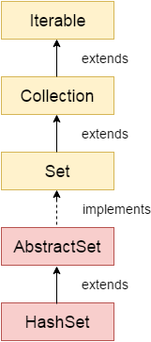
Difference between List and Set
A list can contain duplicate elements whereas Set contains unique elements only.
Hierarchy of HashSet class
The HashSet class extends AbstractSet class which implements Set interface. The Set interface inherits Collection and Iterable interfaces in hierarchical order.

Slide 43
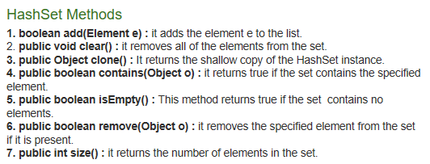

Slide 44
class Smart
{ public static void main(String[] args)
{ HashSet<Object> hashset = new HashSet<Object>();
Hashset.add(“Java”);
Hashset.add(“Collections”);
Hashset.add(“by Smart”);
Hashset.add(“Java”);
System.out.pritln(“The Set is”+ hashset);
}}

Slide 45
Example Java program to demonstrate internal working of HashSet
import java.util.HashSet;
class Test
{ public static void main(String args[])
{ HashSet hs = new HashSet();
boolean b1 = hs.add("Smart");
boolean b2 = hs.add("Smartwatch");
// adding duplicate element
boolean b3 = hs.add("Smart");
// printing b1, b2, b3
System.out.println("b1 = "+b1);
System.out.println("b2 = "+b2);

Slide 46
System.out.println("b3 = "+b3);
// printing all elements of hashset
System.out.println(hs);
}
}
Output:
b1 = true
b2 = true
b3 = false
[Smartwatch, Smart]

Slide 47
Basic operations on the Set - Union, Intersection and Difference.
public static void main(String args[]) {
Set<Integer> a = new HashSet<Integer>();
a.addAll(Arrays.asList(new Integer[] {1, 3, 2, 4, 8, 9, 0}));
Set<Integer> b = new HashSet<Integer>();
b.addAll(Arrays.asList(new Integer[] {1, 3, 7, 5, 4, 0, 7, 5}));
// To find union
Set<Integer> union = new HashSet<Integer>(a);
union.addAll(b);
System.out.print("Union of the two Set");
System.out.println(union);
// To find intersection
Set<Integer> intersection = new HashSet<Integer>(a);
intersection.retainAll(b);
System.out.print("Intersection of the two Set");
System.out.println(intersection);
// To find the symmetric difference
Set<Integer> difference = new HashSet<Integer>(a);
difference.removeAll(b);
System.out.print("Difference of the two Set");
System.out.println(difference);
}

Slide 48
Output
Union of the two Set[0, 1, 2, 3, 4, 5, 7, 8, 9]
Intersection of the two Set[0, 1, 3, 4]
Difference of the two Set[2, 8, 9]

Slide 49
LinkedHashSet
It implements a Set interface.
LinkedHashSet unlike HashSet maintains insertion order. That is elements are placed in the order they are inserted.
It should be preferred if you want a unique collection of objects in an insertion order.

Slide 50
Calculating Size and Searching for an Element in the LinkedHashSet
import java.util.*;
public class Example1 {
public static void main(String args[]) {
LinkedHashSet hs=new LinkedHashSet();
// Adding elements to the LinkedHashSet
hs.add(“S");
hs.add(“m");
hs.add(“a");
hs.add("r");
hs.add(“t");

Slide 51
// Getting the size of the LinkedHashSet
System.out.println("The size of the LinkedHashSet is "+ hs.size());
// Checking whether the LinkedHashSet contains an element or not
System.out.println("Is B Present in the LinkedHashSet?: "+ hs.contains("B"));
// Checking whether the LinkedHashSet contains an element or not
System.out.println("Is S Present in the LinkedHashSet?: "+ hs.contains("E"));
} }
Output:
The size of the LinkedHashSet is 7
Is B Present in the LinkedHashSet?: false
Is S Present in the LinkedHashSet?: true

Slide 52
Removing an Element from the LinkedHashSet
import java.util.*;
public class Example2 {
public static void main(String args[]) {
LinkedHashSet hs=new LinkedHashSet();
// Adding elements to the LinkedHashSet
hs.add(“S");
hs.add(“m");
hs.add(“a");
hs.add("r");
hs.add(“t");

Slide 53
System.out.println("Original LinkedHashSet: " + hs);
// Removing element e from the LinkedHashSet
System.out.println("Removal Status: "+hs.remove(“a"));
// Displaying the updated LinkedHashSet
System.out.println("Updated LinkedHashSet: "+ hs); } }
Output:
Original LinkedHashSet: [S, m, a, r, t]
Removal Status: true
Updated LinkedHashSet: [S, m, r, t]

Slide 54
SortedSet Interface 1. This interface extends a set whose iterator transverse its elements according to their natural ordering. 2. TreeSet implements the sorted interface.

Slide 55
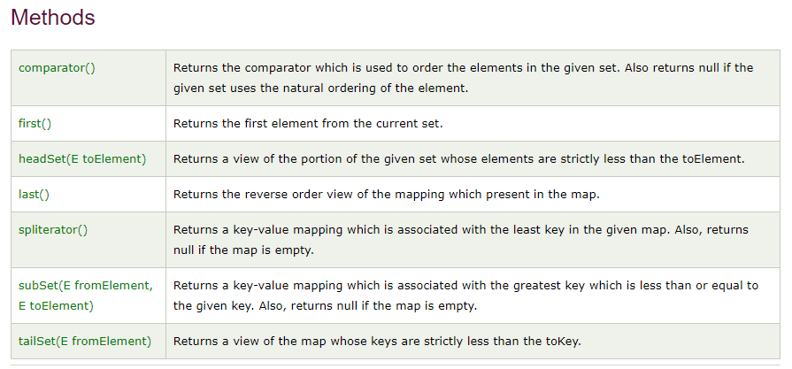
Sorted Set Methods

Slide 56
TreeSet Class
TreeSet is a sorted collection that extends the AbstractSet class and implements the NavigableSet interface.
It stores unique elements.
It doesn’t preserve the insertion order of the elements.
It sorts the elements in ascending order.
TreeSet class access and retrieval times are quiet fast.
TreeSet class doesn't allow null element.

Slide 57
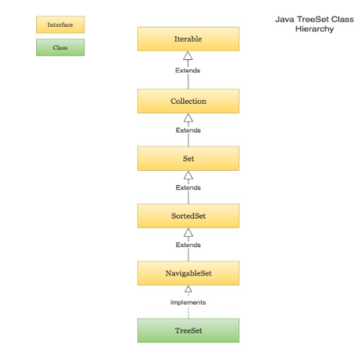

Slide 58
Tree Set Constructors
TreeSet t = new TreeSet(); This will create empty TreeSet object in which elements will get stored in default natural sorting order.
TreeSet t = new TreeSet(Comparator comp); This constructor is used when external specification of sorting order of elements is needed.
TreeSet t = new TreeSet(Collection col); This constructor is used when any conversion is needed from any Collection object to TreeSet object.
TreeSet t = new TreeSet(SortedSet s); This constructor is used to convert SortedSet object to TreeSet Object.

Slide 59
TreeSet Methods
1. boolean add(Object o)
2. boolean addAll(Collection c)
3. void clear()
4. boolean isEmpty()
5. boolean remove(Object o)
6. boolean contains(Object o)
7. int size()
8. Iterator iterator()
9. Spliterator spliterator()
10. Object clone()
11. Iterator descendingIterator(): It is used to iterate the elements in descending order.

Slide 60
Methods Defined by SortedSet Interface
1. Object first(): It is used to get the first (lowest) element currently in the sorted set.
2. Object last(): This method returns the last (highest) element currently in the sorted set.
3. Comparator comparator(): It returns comparator that is used to order elements in the set. If the TreeSet uses the natural ordering, this method returns null.
4. SortedSet headSet(Object toObject): This method returns the collection of elements that are less than the specified element.
5. SortedSet subSet(Object fromElement, Object toElement): It returns elements from the set that lie between the given range in which fromElement is included and toElement is excluded.
6. SortedSet tailSet(Object fromElement): It returns elements from the set that is greater than or equal to the specified element.

Slide 61
Methods Defined by NavigableSet Interface 1. Object ceiling(Object o): It returns the lowest element from the set equal to or greater than the specified element. If no such element is found, it returns null. 2. Object floor(Object o): It returns the greatest element from the set equal to or less than the specified element. If no such element is found, it returns null element. 3. Object lower(Object o): This method returns the largest element from the set strictly less than the specified element. If no such element is found, it will return null element. 4. Object higher(Object o): This method returns the smallest element from the set strictly greater than the specified element. If no such element is found, it will return null element. 5. Object pollFirst(): It is used to remove and retrieve the first element in the tree set.

Slide 62
Methods Defined by NavigableSet Interface 6. Object pollLast(): It is used to remove and retrieve the last element in the tree set. 7. NavigableSet descendingSet(): This method returns elements in reverse order. 8. NavigableSet headSet(Object toObject, boolean inclusive): This method returns the collection of elements that are less than or equal to (if, inclusive is true) the specified element. 9. NavigableSet subSet(Object fromElement, boolean fromInclusive, Object toElement, boolean toInclusive): This method returns elements from the set that lie between the specified range. 10. NavigableSet tailSet(Object fromElement, boolean inclusive): It returns elements from the set that is greater than or equal to (if, inclusive is true) the specified element.

Slide 63
import java.util.*;
public class TreSetMethodsDemo {
public static void main(String args[]){
TreeSet <String> treeSetObject2 = new TreeSet<String>();
treeSetObject2.add("B");
treeSetObject2.add("C");
treeSetObject2.add("A");
treeSetObject2.add("D");
treeSetObject2.add("A");
System.out.println("Values in TreeSet object 2: " +treeSetObject2);
}
Output:
Values in TreeSet object 2: [A, B, C, D]

Slide 64
AddAll(Collection e) Ex:
public class TreSetMethodsDemo1 {
public static void main(String args[]){
TreeSet <Integer>treeSetObject1 = new TreeSet<Integer>();
TreeSet <Integer>treeSetObject2 = new TreeSet<Integer>();
treeSetObject1.add(3);
treeSetObject1.add(5);
treeSetObject1.add(1);
treeSetObject1.add(2);
treeSetObject2.add(9);

Slide 65
treeSetObject2.add(11);
treeSetObject2.add(1);
treeSetObject2.add(7);
treeSetObject1.addAll(treeSetObject2);
System.out.println("Values in TreeSet object 1: " +treeSetObject1);
}
Output:

Slide 66
import java.util.*;
public class SortedSetMethodsDemo {
public static void main(String args[]){
TreeSet <String> treeSetObject2 = new TreeSet<String>();
treeSetObject2.add("B");
treeSetObject2.add("C");
treeSetObject2.add("A");
treeSetObject2.add(“D");
System.out.println("Values in TreeSet object 2: " +treeSetObject2);
System.out.println("The first element is given as: " + treeSetObject2.first());
System.out.println("The last element is given as: " + treeSetObject2.last());

Slide 67
System.out.println("The respective element is given as: " + treeSetObject2.headSet(“B"));
//Returns a view of the map whose keys are strictly less than the toKey. System.out.println("The respective element is given as: " +treeSetObject2.tailSet(“D"));
}

Slide 68
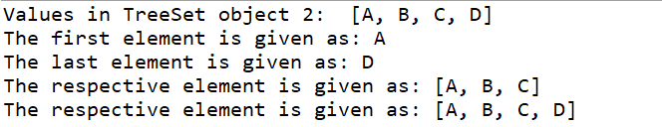
Output:

Slide 69
import java.util.NavigableSet;
import java.util.TreeSet;
public class TreeSetEx
{
public static void main(String[] args)
{
NavigableSet<Integer> ns = new TreeSet<>();
ns.add(0);
ns.add(1);
ns.add(2);
ns.add(3);
ns.add(4);
ns.add(5);
ns.add(6);
System.out.println("lower(3): " + ns.lower(3));
System.out.println("floor(3): " + ns.floor(3));
System.out.println("higher(3): " + ns.higher(3));
System.out.println("ceiling(3): " + ns.ceiling(3));
System.out.println("pollFirst(): " + ns.pollFirst());
System.out.println("Navigable Set: " + ns);
System.out.println("pollLast(): " + ns.pollLast());
System.out.println("Navigable Set: " + ns);

Slide 70
NavigableSet<Integer> reverseNs = ns.descendingSet();
// Print the normal and reverse views
System.out.println("Normal order: " + ns);
System.out.println("Reverse order: " + reverseNs);
NavigableSet<Integer> threeOrMore = ns.tailSet(3, true);
System.out.println("3 or more: " + threeOrMore);
System.out.println("pollFirst(): " + ns.pollFirst());
System.out.println("Navigable Set: " + ns);
System.out.println("pollFirst(): " + ns.pollFirst());
System.out.println("Navigable Set: " + ns);
System.out.println("pollFirst(): " + ns.pollFirst());
System.out.println("pollLast(): " + ns.pollLast());
}}

Slide 71
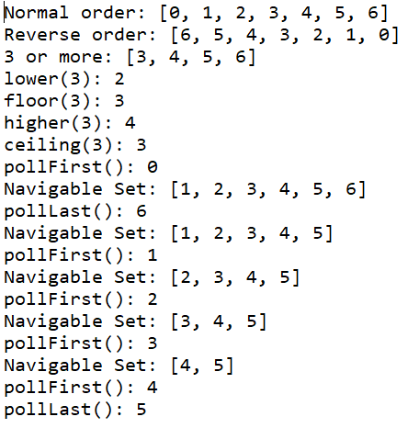
Output:

Slide 72
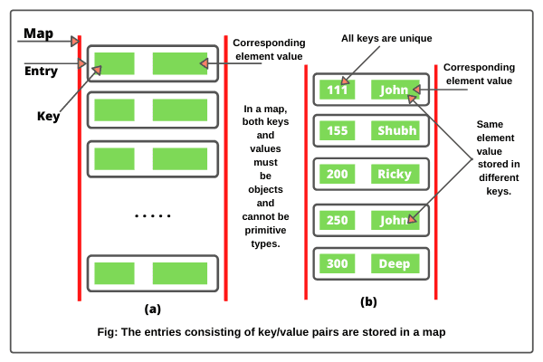
MAP Interface -Map interface in Java is defined in java.util.Map package. -It is a part of the Java collections framework but it does not extend the collection interface. -A map in Java is a container object that stores elements in the form of key and value pairs. -A key is a unique element (object) that serves as an “index” in the map.

Slide 73
MAP Interface -The element that is associated with a key is called value. -A map stores the values associated with keys. -In a map, both keys and values must be objects and cannot be primitive types. -A map cannot have duplicate keys. -Each key maps to only one value. -This type of mapping is called one-to-one mapping in java. -All keys must be unique, but values may be duplicate.

Slide 74
map interface is defined as: public interface Map<K, V> // K defines the type of keys and V defines the type of values. Example: mapping of Integer keys and String values can be represented with a Map<Integer,String> The Map interface provides the methods for fast retrieval, deletion, and updating of the pair through the key.

Slide 75
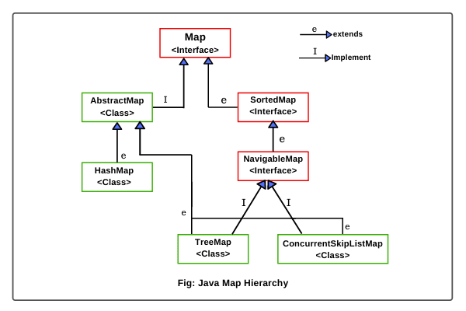

Slide 76
Map Implementation Classes 1. AbstractMap: It is an abstract class that implements map interface. It is the parent class of all concrete map implementation classes such as HashMap, TreeMap, and LinkedHashMap. It implements all methods in Map interface except entrySet() method. 2. EnumMap: The EnumMap class extends AbstractMap and implements Map interface. It is especially for use with keys of Enum type. 3. HashMap: It is a concrete class that extends AbstractMap. It uses a hash table to store elements. It is mainly used for locating a value, inserting, and deleting an entry. 4. TreeMap: It is a concrete class that extends AbstractMap and implements NavigableMap interface. It used a tree for storing elements. It is used for traversing keys in sorted order. The keys can be sorted using the Comparable interface or Comparator interface.

Slide 77
5. LinkedHashMap: It is a concrete class that provides implementation of Java map interface. It extends HashMap class with a linked-list implementation that supports the insertion order of entries in the map. The entries in a HashMap are not ordered, but entries in a LinkedHashMap can be retrieved in the order in which they were inserted into the map. 6. WeakHashMap: The WeakHashMap class extends AbstractMap interface to use a hash table with keys of weak type. Weak keys allow an element in a map to be garbage collected when its key is no longer used anywhere in the program. 7. IdentityHashMap: This class extends AbstractMap and uses reference equality for comparing entries. This class is not used for general purposes.

Slide 78
SYNTAX: a) Map<K, V> map = new HashMap<>(); // It create an empty map. b) Map<K, V> map = new HashMap<>(Map m); // It creates a map with initializing elements of m. c) Map<K, V> map = new HashMap<>(int initialCapacity); // It creates a map with initialization of initial capacity of HashMap. d) Map<K, V> map = new HashMap<>(int initialCapacity, float fillRatio); // It creates a map object with initializing both initial capacity and fill ratio of HashMap.

Slide 79
Map Methods 1. V put(K key, V value): It is used to add an entry with specified key and value in the map. 2. void putAll(Map m): It is used to add all entries from into this map. 3. V putIfAbsent(K key, V value): It is used to add specified value with specified key in the map only if it is not already specified. 4. V remove(Object key): This method is used to delete an entry for the specified key. It will return null if the key is not in the map. 5. boolean remove(Object key, Object value): This method is used to remove the specified value associated with specified key from the map. 6. Set<K> keySet(): This method returns a set consisting of the keys in the invoking map. It provides a set-view of the keys.

Slide 80
Map Methods 7. void clear(): This method is used to remove all entries from the map. 8. V get(Object key): This method returns the value for the specified key in this map. 9. int hashCode(): It returns the hash code value for the invoking map. 10. boolean isEmpty(): This method is used to check whether the map contains any entries. It returns true if the invoking map is empty, otherwise returns false if it contains at least one key. 11. int size(): The size() method returns the number of entries (number of key/value pairs) in the map. 12. V replace(K key, V value): This method is used to replace the specified value for a specified key.

Slide 81
Map Methods 13. boolean replace(K key, V oldValue, V newValue): This method is used to replace old value with new value for a specified key. 14. Collection<V> values(): This method returns a collection view of the values in the map. 15. boolean containsKey(Object key): This method is used to check whether the map contains an entry for the specified key. It returns true if the invoking map contains an entry for the specified key. Otherwise, returns false. 16. boolean containsValue(Object value): This method is used to check whether the map contains an entry for the specified value. It returns true if the map contains specified value. Otherwise, returns false. 17. boolean equals(Object obj): This method is used to compare the specified Object with map. If obj is a map and contains the same entries, it returns true otherwise, false.

Slide 82
HashMap -An unordered collection that stores elements (objects) in the form of key-value pairs (called entries). -It is expressed as HashMap<Key, Value>, or HashMap<K, V>, where K stands for key and V for value. -Both Key and value are objects. -If the key is provided, its associated value can be easily retrieved from the HashMap. -Keys in the map must be unique which means we cannot use duplicate data for keys in the HashMap. -If we try to insert an entry that has a duplicate key, the map replaces the old entry with a new entry. -It is efficient for locating a value, adding an entry, and deleting an entry.

Slide 83
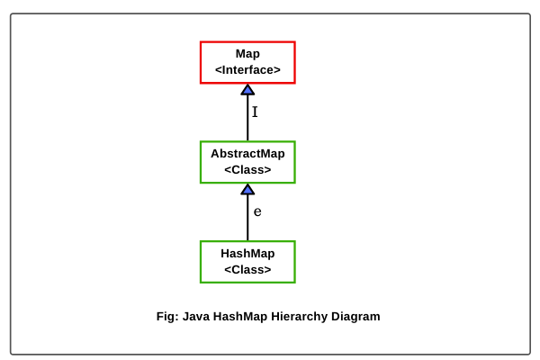

Slide 84
1. HashMap(): It is used to construct an empty HashMap object with the default initial capacity of 16 and the default fill ratio (load factor) is 0.75. The syntax to create a hash map object is as follows: HashMap hmap = new HashMap(); HashMap<K, V> hmap = new HashMap<K,V>(); // Generic form. 2. HashMap(int initialCapacity): It is used to create an empty hash map object with a specified initial capacity under the default load factor 0.75. The general syntax is as follows: HashMap<K,V> hmap = new HashMap<K,V>(int initialCapacity); 3. HashMap(Map m): This constructor is used to create hash map object by initializing the elements of the given Map object m. 4. HashMap(int initialCapacity, float loadFactor): This constructor is used to create hash map object with specified initial capacity and load factor.

Slide 85
EXAMPLE: HashMap<String, Integer> hmap = new HashMap<>(30, 0.7f);

Slide 86
import java.util.HashMap; public class HashMapEx1 { public static void main(String[] args) { HashMap<String,Integer> hmap = new HashMap<>(); boolean empty = hmap.isEmpty(); System.out.println("Is HashMap empty: " +empty); hmap.put("John", 24); // hmap.size() is 1. hmap.put("Deep", 22); // hmap.size() is 2. hmap.put("Shubh", 15); // hmap.size() is 3. hmap.put("Riky", 22); // hmap.size() is 4. // Adding duplicate value. hmap.put("Mark", 30); // hmap.size() is 5. System.out.println("Entries in HashMap: " +hmap); int size = hmap.size(); System.out.println("Size of HashMap: " +size);

Slide 87
hmap.put(null, null); // hmap.size() is 6. System.out.println("Updated entries in HashMap: " +hmap); hmap.put(10, "Guava"); // Still hmap.size is 3. hmap.put(20, "Banana"); // Adding duplicate value. //Removing Key-Value pairs for key 'B'. Object removeEntry = hmap.remove('B'); System.out.println("Removed Entry: " +removeEntry); Object replaceValue = hmap.replace('B', "Black"); System.out.println("Replaced value: " +replaceValue); int number = hmap.get("Deep"); System.out.println("Deep's number: " +number); } }

Slide 88
TreeMap -TreeMap in Java is a concrete class that is a red-black tree based implementation of the Map interface. -It provides an efficient way of storing key/value pairs in sorted order automatically and allows rapid retrieval. -A TreeMap implementation provides guaranteed log(n) time performance for checking, adding, retrieval, and removal operations. Main differences between HashMap and TreeMap 1.HashMap is an unordered collection of elements while TreeMap is sorted in the ascending order of its keys. 2.The keys are sorted either using Comparable interface or Comparator interface. 3.HashMap allows only one null key while TreeMap does not allow any null key.

Slide 89
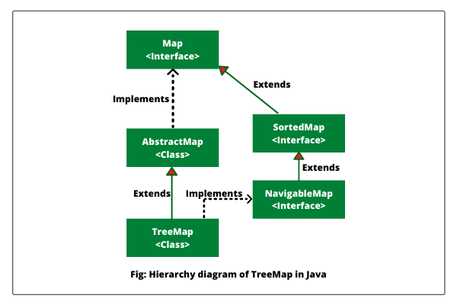

Slide 90
import java.util.TreeMap; public class TreeMapEx2{ public static void main(String[] args) { TreeMap<String, Integer> tmap = new TreeMap<>(); int size = tmap.size(); System.out.println("Size of TreeMap before adding entries: " +size); boolean isEmpty = tmap.isEmpty(); System.out.println("Is TreeMap empty: " +isEmpty); tmap.put("John", 25); tmap.put("Ricky", 22); tmap.put("Deep", 28); tmap.put("Mark", 20); tmap.put("Peter", 30); System.out.println("Entries in ascending order: " +tmap); tmap.remove("Mark"); System.out.println("Entries of TreeMap after removing: " +tmap); tmap.replace("Peter", 18); System.out.println("Updated enrties of TreeMap: " +tmap); } }

Slide 91
import java.util.TreeMap; public class TreeMapEx1{ public static void main(String[] args) { // Creating a TreeMap object of generic type. TreeMap<Character, String> tmap = new TreeMap<>(); // Adding entries in tree map. tmap.put('A', "Apple"); tmap.put('P', "Parot"); tmap.put('C', "Cat"); tmap.put('B', "Boy"); tmap.put('D', "Dog"); Object entrySet = tmap.entrySet(); System.out.println("Entry set: " +entrySet); System.out.println("Key set: " +tmap.keySet()); System.out.println("Value set: " +tmap.values()); Object vGet = tmap.get('C'); System.out.println("C: " +vGet); boolean containsKey = tmap.containsKey('B'); System.out.println("Is key 'B' present in map: " +containsKey); boolean containsValue = tmap.containsValue("Apple"); System.out.println("Is Apple present in map: " +containsValue); } }

Slide 92
import java.util.TreeMap; public class TreeMapEx1{ public static void main(String[] args) { TreeMap<Integer, String> tmap = new TreeMap<>(); tmap.put(25, "John"); tmap.put(22, "Shubh"); tmap.put(30, "Ricky"); tmap.put(35, "Peter"); tmap.put(18, "Johnson"); System.out.println("ceilingEntry: " +tmap.ceilingEntry(32)); System.out.println("ceilingKey: " +tmap.ceilingKey(32)); System.out.println("firstEntry: " +tmap.firstEntry()); System.out.println("lastEntry: " +tmap.lastEntry()); System.out.println("floorEntry: " +tmap.floorEntry(31)); System.out.println("HigherEntry: " +tmap.higherEntry(30)); System.out.println("LowerEntry: " +tmap.lowerEntry(30)); System.out.println("pollFirstEntry: " +tmap.pollFirstEntry()); System.out.println("pollLastEntry: " +tmap.pollLastEntry()); } }

Slide 93
Output: ceilingEntry: 35=Peter ceilingKey: 35 firstEntry: 18=Johnson lastEntry: 35=Peter floorEntry: 30=Ricky HigherEntry: 35=Peter LowerEntry: 25=John pollFirstEntry: 18=Johnson pollLastEntry: 35=Peter

Slide 94
Hashtable class -The underlying data structure for Java Hashtable is a hash table only. -Insertion order is not preserved. -Duplicate keys are not allowed but values can be duplicated. -Heterogeneous objects are allowed for both keys and values. -Null is not allowed for both key and values. If we attempt to store null key or value, we will get a RuntimeException named NullPointerException.

Slide 95
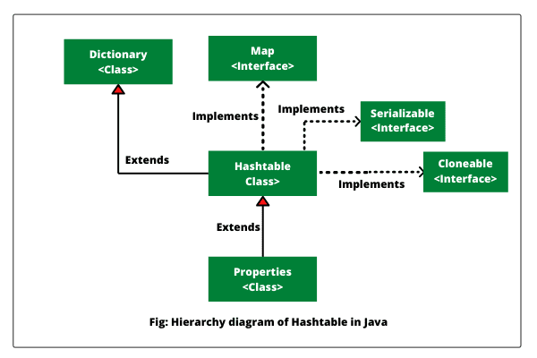

Slide 96
Difference between hashmap and hashtable
HashMap | Hashtable
1) HashMap is non synchronized. It is not-thread safe and can't be shared between many threads without proper synchronization code. | Hashtable is synchronized. It is thread-safe and can be shared with many threads.
2) HashMap allows one null key and multiple null values. | Hashtable doesn't allow any null key or value.
3) HashMap is a new class introduced in JDK 1.2. | Hashtable is a legacy class.
4) HashMap is fast. | Hashtable is slow.

Slide 97
import java.util.Hashtable; import java.util.Iterator; import java.util.Map.Entry; class HashtableEx { public static void main(String[] args) { Hashtable<String, Integer> ht = new Hashtable<>(); ht.put("John", 20); ht.put("Shubh", 30); ht.put("Peter", 25); ht.put("Deep", 15); ht.put("Jonshan", 40); System.out.println("Original entries of hash table: " +ht);

Slide 98
// Iterating elements of hash table using iterator() method. System.out.println("Iterating keys of hash table:"); Iterator<String> itr = ht.keySet().iterator(); while(itr.hasNext()) { System.out.println(itr.next()); } System.out.println("Iterating values of hash table:"); Iterator<Integer> itrValue = ht.values().iterator(); while(itrValue.hasNext()) { System.out.println(itrValue.next()); } System.out.println("\n"); System.out.println("Iterating entries of hash table:"); Iterator<Entry<String, Integer>> itrEntry = ht.entrySet().iterator(); while(itrEntry.hasNext()) { System.out.println(itrEntry.next()); } } }

Slide 99
Output: Original entries of hash table: {John=20, Jonshan=40, Shubh=30, Deep=15, Peter=25} Iterating keys of hash table: John Jonshan Shubh Deep Peter Iterating values of hash table: 20 40 30 15 25 Iterating entries of hash table John=20 Jonshan=40 Shubh=30 Deep=15 Peter=25

Slide 100
Iterator Interface
Iterator interface is used to iterate over the elements of a Collection (List, Set or Map).
The Iterator helps in retrieving the elements from the specified collection one by one and optionally performs operations over each element.
All Java collection classes provide iterator() method which returns the instance of Iterator to walk over the elements in that collection.

Slide 101
Iterator Interface
Iterator Methods
The Iterator interface has 4 methods used to perform various operations:
hasNext()
next()
remove()
forEachRemaining()

Slide 102
Iterator Methods
Iterator.hasNext()
This method returns true if the iteration has more elements remaining in the collection.
If the iterator has gone over all elements, then this method will return false.
Iterator.next()
This method returns the next element in the iteration.
It throws NoSuchElementException if the iteration has no more elements.

Slide 103
EXAMPLE
List<Integer> numbers = List.of(1, 2, 3, 4, 5);
Iterator<Integer> iterator = numbers.iterator();
int number = iterator.next(); //1
int number = iterator.next(); //2

Slide 104
Iterator Methods
Iterator.remove()
-It removes from the underlying collection the last element returned by the iterator .
-This method can be called only once per call to next().
-If the underlying collection is modified while the iteration is in progress in any way other than by calling remove() method, the iterator will throw an ConcurrentModificationException.
List<Integer> numbers = List.of(1, 2, 3, 4, 5);
Iterator<Integer> iterator = numbers.iterator();
int number = iterator.next(); //1
iterator.remove();
System.out.println(numbers); [2, 3, 4, 5]

Slide 105
Iterator Methods
Iterator.forEachRemaining()
-This method performs the given action for each remaining element until all elements have been processed or the action throws an exception.
-Actions are performed in the order of iteration if that order is specified.
-It throws NullPointerException if the specified action is null.
List<Integer> numbers = List.of(1, 2, 3, 4, 5);
Iterator<Integer> iterator = numbers.iterator();
while(iterator.hasNext()) {
iterator.forEachRemaining(System.out::println); //1 2 3 4 5
}

